Slide 1
Smart Car Parking System
Presented by-
Nur-A Khadija Khandaker Piya -222400003
Mst Monira Khatun -222400019
Jannatul Firdous Samiya -222400024
Course Title – Computer Peripheral Lab
Course Code – CSE 326
Department Of CSE

Slide 2
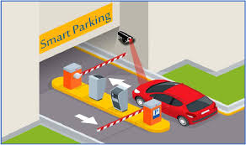
Introduction
Smart Car Parking System –
A system that automates vehicle entry and exit in parking areas
Detects cars using sensors and operates a gate automatically
Displays parking information using an LCD screen
Helps reduce manual work and improve efficiency

Slide 3

Project Objectives
Control vehicle movement inside parking areas
Automate entry/exit gates
Display real-time parking status
Save time and reduce human effort
Ensure organized parking

Slide 4
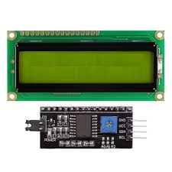
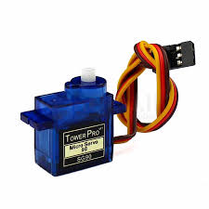
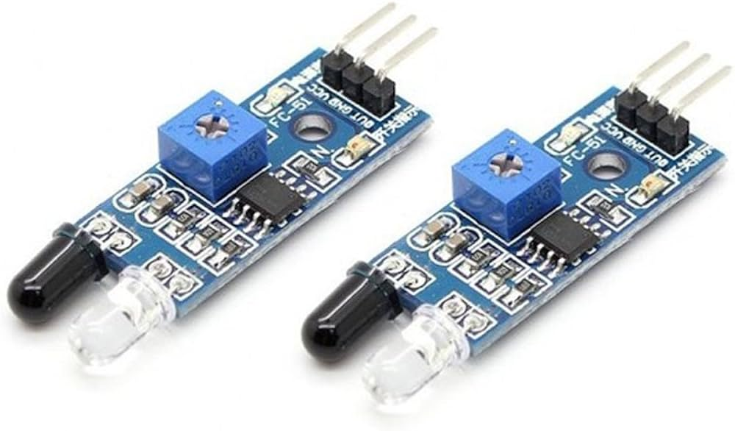
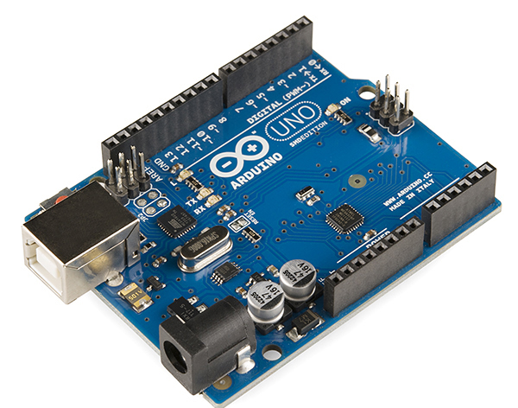
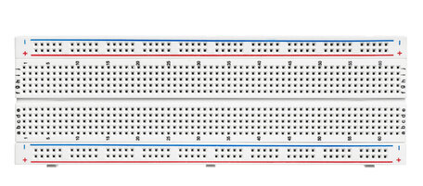
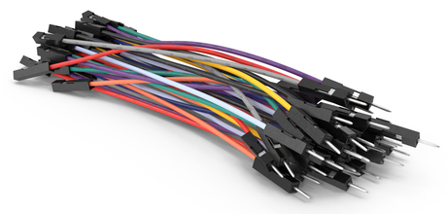
Components Used
Arduino Uno
Breadboard
IR Sensors
Servo Motor
I2C LCD Display
Jumper Wires (Male to Male and Male to Female)

Slide 5
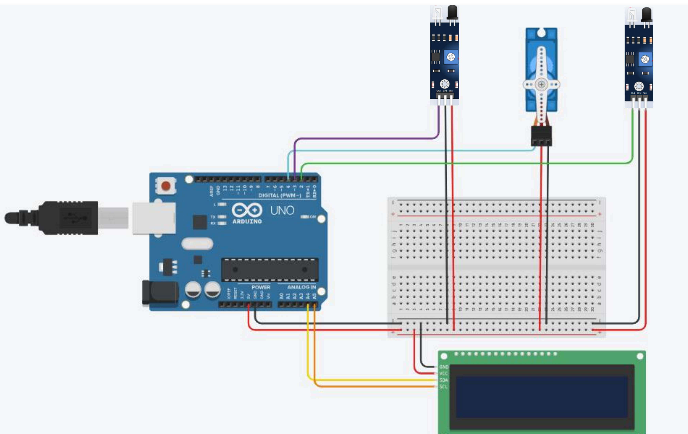
Circuit Diagram

Slide 6
Working Principle
IR Sensor 1 detects a car at the entry
The Arduino sends a signal to the Servo Motor to open the gate
As the car passes IR Sensor 2, the system updates the count
LCD Display shows messages like “Free 0”, “Occupied 4” , “Parking Full”, etc.
After a few cars, if parking is full, the gate remains closed

Slide 7
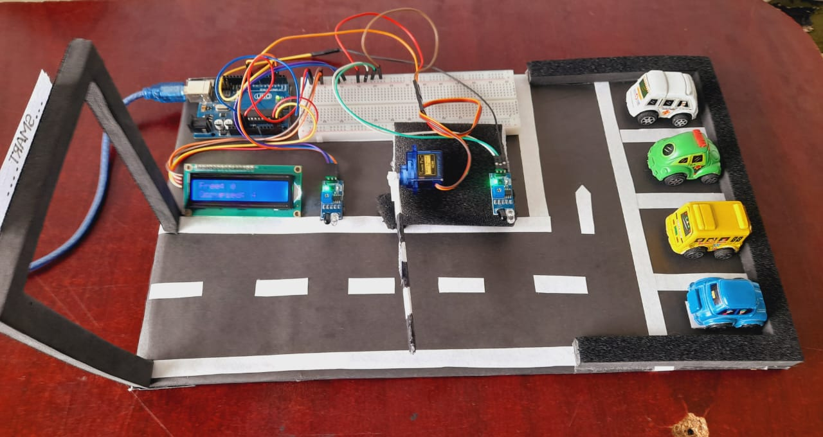
Project Model Overview
This is the complete prototype of our Smart Car Parking System. It uses sensors and automation to detect vehicles, open/close the gate, and show parking status on the LCD display. The system is powered by Arduino and is built on a compact layout using real-world logic.

Slide 8
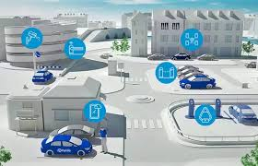
Real-life Applications
Shopping malls
Hospitals
Residential complexes
Office parking
Smart city projects

Slide 9
Advantages
Reduces manual effort
Saves time
Ensures better parking management
Easy to use and low-cost solution
Can be expanded or upgraded

Slide 10
Limitations and Future Scope
Limited to fixed car slots (not dynamic)
Future improvements:
Mobile app integration
Camera-based detection
Cloud data storage and remote monitoring

Slide 11
Conclusion
A simple yet effective model to automate parking
Shows how embedded systems can solve real-world problems
Can be improved for advanced commercial use

